Slide 1
Introduction
簡廷因 Ting-Ying Chien
2023.02.18

Slide 2
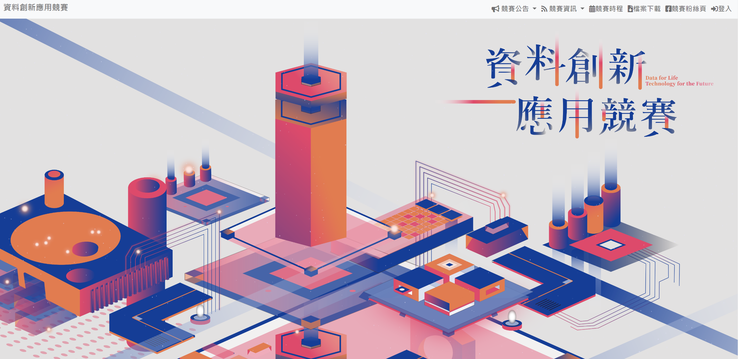
FYI
資料創新應用競賽
https://opendata-contest.tca.org.tw/

Slide 3
FYI
2024中研院資訊科學研究所暑期實習生研究計畫
https://www.iis.sinica.edu.tw/zh/page/Recruitment/SummerInterns/SummerInterns_2024.html
申請期間
2024/02/15~2024/03/15
參與研究時間
2024/07/01~2024/08/30

Slide 4
What is Big Data?
Big data usually includes data sets with sizes beyond the ability of commonly used software tools to capture, curate, manage, and process data within a tolerable elapsed time.
Big data "size" is a constantly moving target, as of 2012 ranging from a few dozen terabytes to many petabytes of data. Big data is a set of techniques and technologies that require new forms of integration to uncover large hidden values from large datasets that are diverse, complex, and of a massive scale.

Slide 5
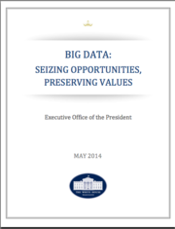
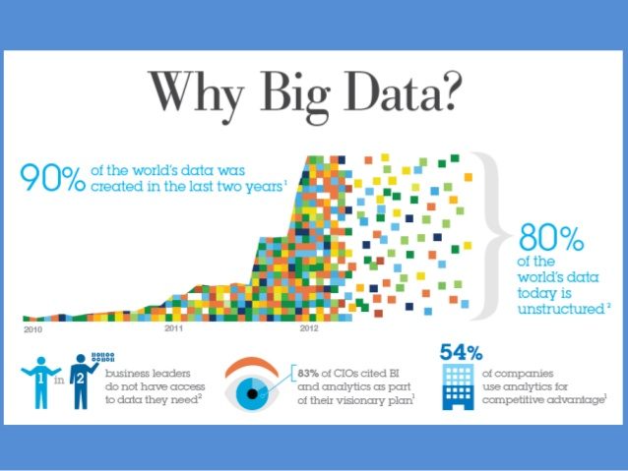
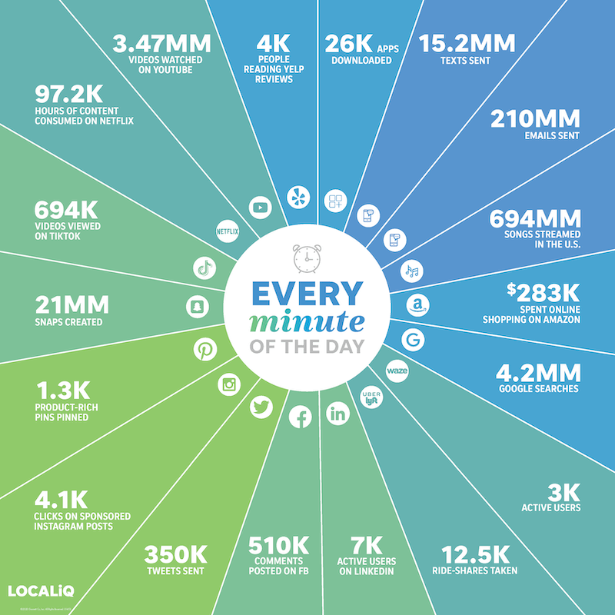
Data Are the King
Data-centric computing will dominate the future!
Now data are of:
High volume
High velocity
High variety
210M Emails sent
4.2M google searches
15.2M text sent
350K tweets sent
510K comment posted on FB
http://image.slidesharecdn.com/bigdatabigrewards-chong-150502043013-conversion-gate01/95/big-data-big-rewards-4-638.jpg?cb=1430559062; http://www.eweek.com/imagesvr_ce/4176/2013_ew_HubDataHP_01.jpg; http://itlaw.wikia.com/wiki/Big_Data:_Seizing_Opportunities,_Preserving_Values
Notes:
美國前總統歐巴馬在他的政策白皮書中寫到 “資料是21世紀的新石油”, 代表資料在21世紀是非常有價值的, 左上這圖顯示近幾年資料量成長的非常快速且大部分的資料為非結構化資料,
這代表在資料分析技術上需要有新的突破, 右下這數據是目前每分鐘所產生的資料量, 大家可以參考一下, 這些數據量是非常驚人的. 也因此在提到大數據都會提到3個V, volume,資料量大
Velocity, 資料即時分析, variety, 資料來源多元, 甚至4v, veracity, 資料可性度, value,資料價值

Slide 6
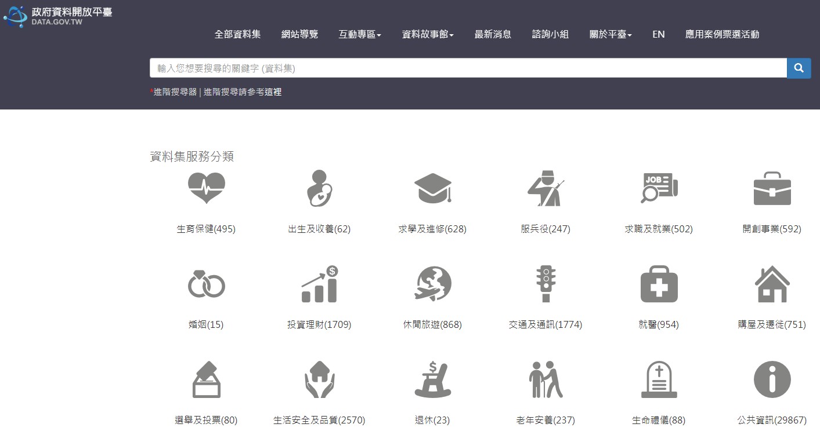
Where is the data?
Government
Open data
http://data.gov.tw/
http://data.coa.gov.tw/
https://dbahr.narlabs.org.tw/
http://taqm.epa.gov.tw/taqm/tw/default.aspx
https://nycopendata.socrata.com/
...
Private data
National Health Insurance Research Database (健保資料庫)
Electronic Receipts Database
ETC
http://cit-etc.net1.tw/honor-ok.asp
…

Slide 7
Where is the data?
Business Data
Customer data
Manufacturing data
…
Competitions
http://www.kaggle.com/competitions
https://aidea-web.tw/
…

Slide 8
Where is the data?
Social Media
FB
Twitter
IG
PTT
Mobile01
…

Slide 9
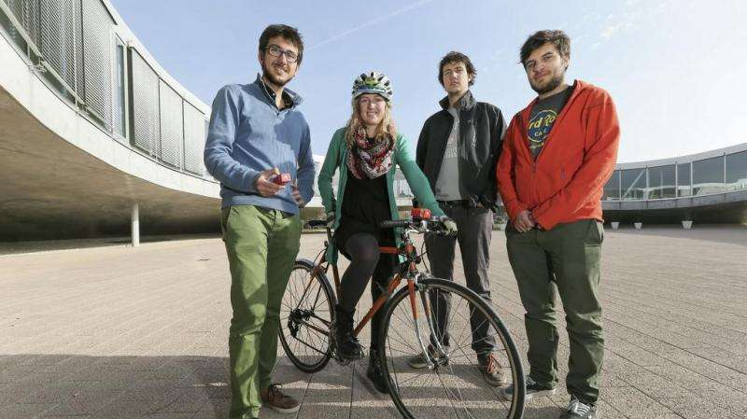
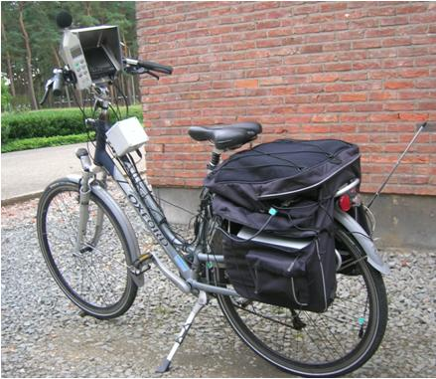
Where is data?
Resident
1999 in Taiwan (311 in New York City)
Ubike
Air pollution data
Ref: http://phys.org/news/2015-11-air-pollution-bicycle.html
Ref: http://www.mdpi.com/1424-8220/13/1/221

Slide 10

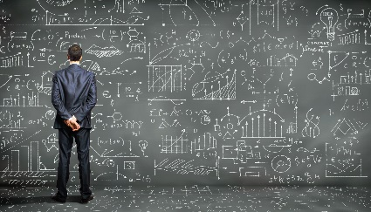
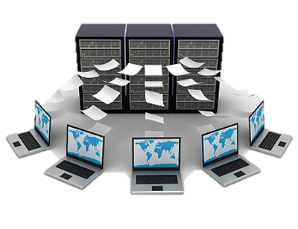
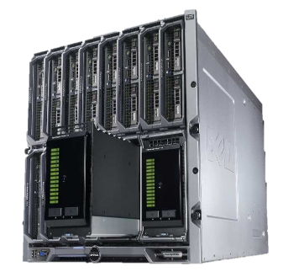

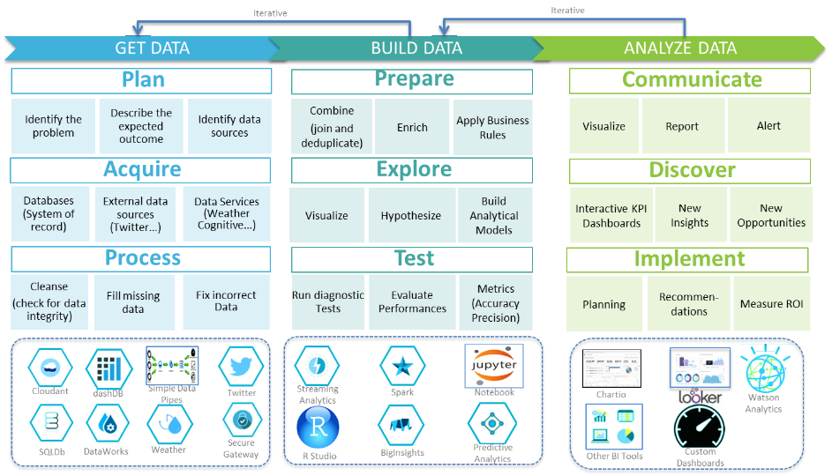

Technologies Need to Keep Up
Data-centric computing makes the computing system design a totally different story…
To-do list throughout the data lifecycle…
Value
Data analytics
Data processing & management
Data storage
Data acquisition
Data
http://icongal.com/gallery/image/11023/page_document_paper_file.png; http://previews.123rf.com/images/grzym/grzym1005/grzym100500020/7050294-A-lot-of-books-tower-made-of-books-against-a-white-background-Stock-Photo.jpg; http://journaling4faith.com/wp-content/uploads/2014/03/TreasureChest-shebusiness.jpg; http://ise.illinois.edu/images/researchareas/data-analytics.jpg http://www.vectiv.com/images/portfolio/recent/item23.png; http://i.ebayimg.com/00/s/MjM2WDMxNQ==/z/zCIAAOSwwo1XfBvb/$_57.JPG?set_id=80000000000
Notes:
從資料蒐集開始到最後產生價值, 中間還必須經過許多步驟, 整體流程大致可分為以下, 資料蒐集完之後需要將這些作儲存並且先經過簡單的處理跟管理, 之後在將這些資料進行分析最後得到資料的價值
右下的圖說明整個大數據分析的流程, 首先需要Get data, 再來是Build Data, 最後是 Analyze Data

Slide 11
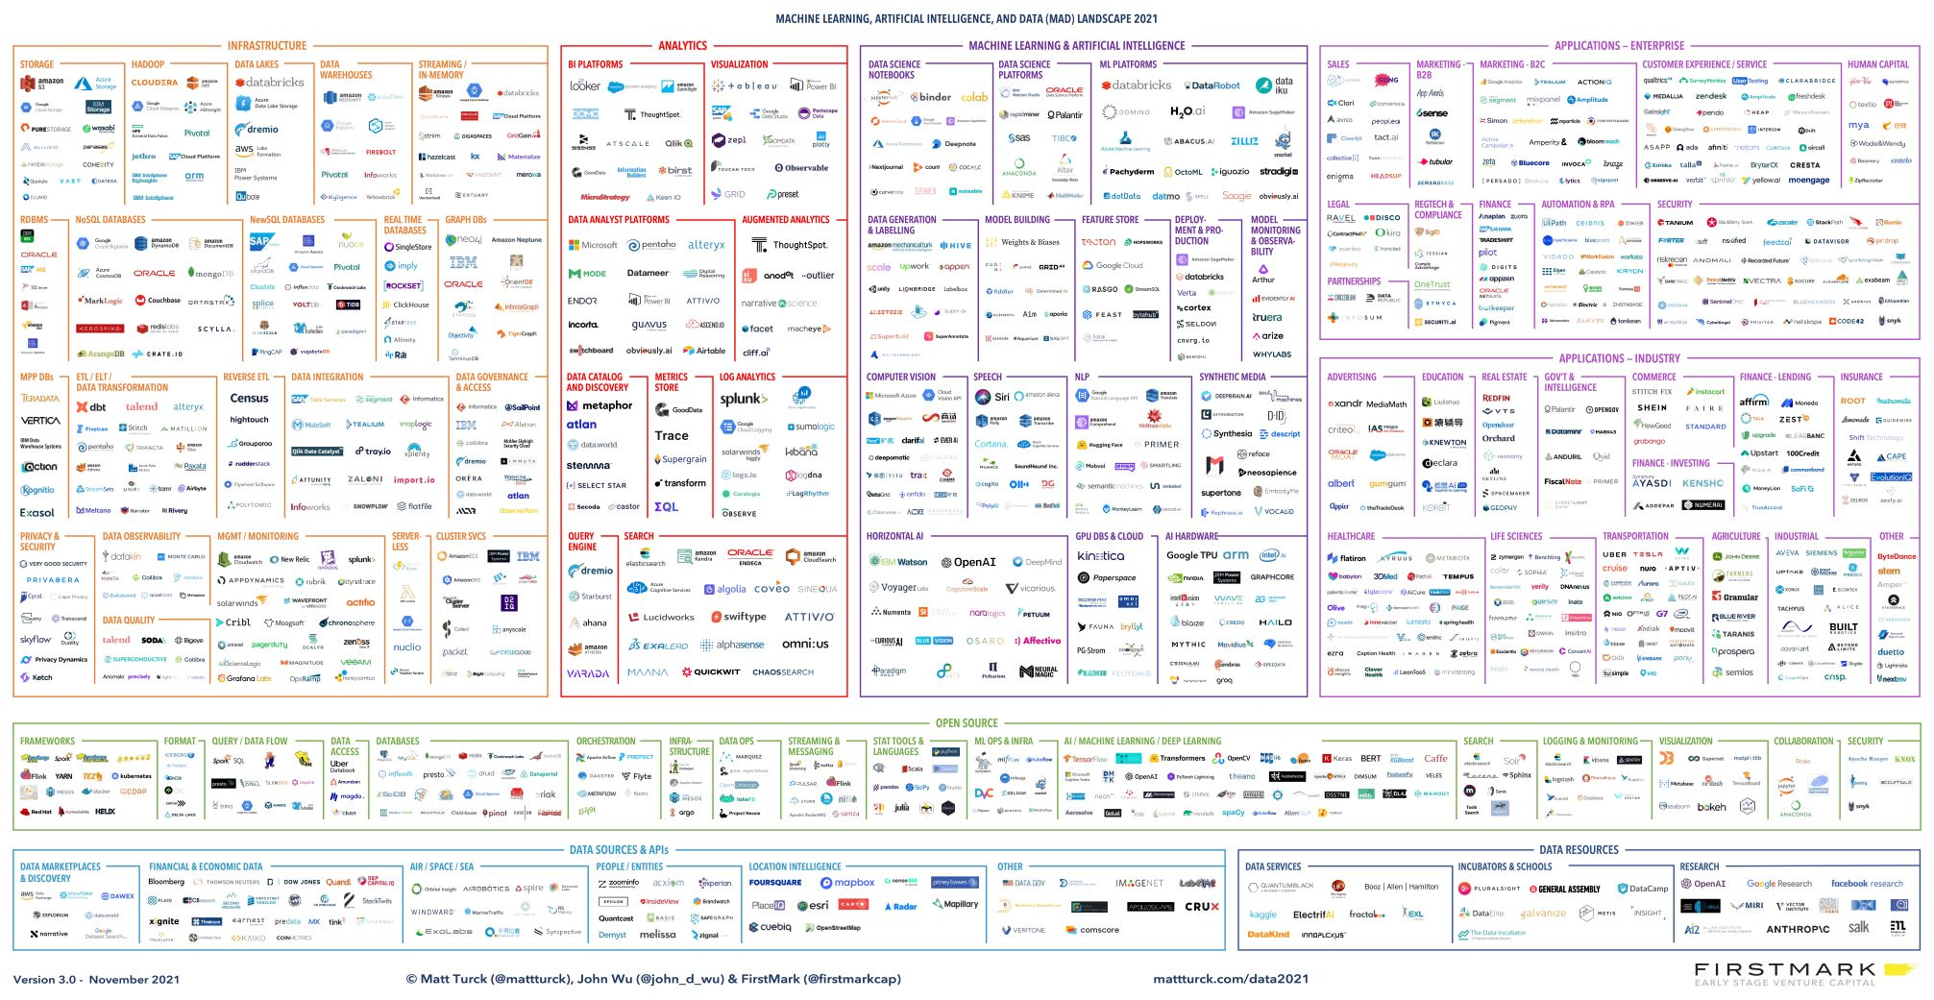
Big Data Landscape
Infrastructure
Analytics
Application

Slide 12


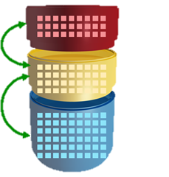
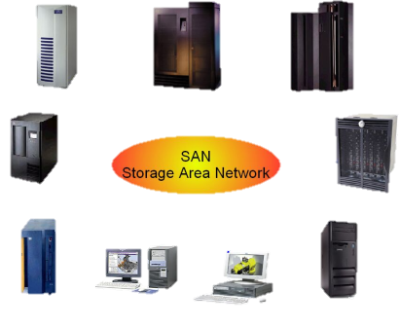
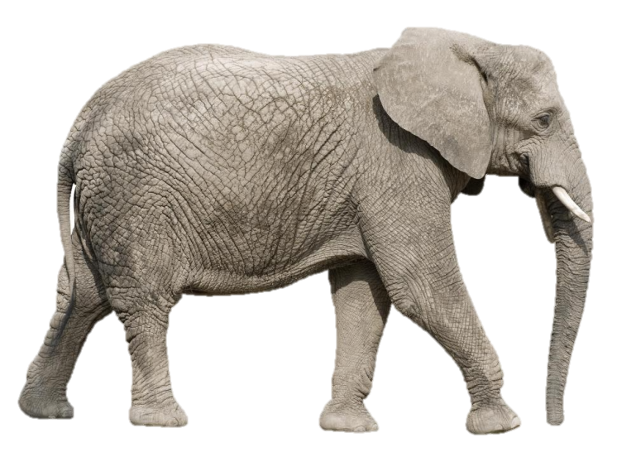
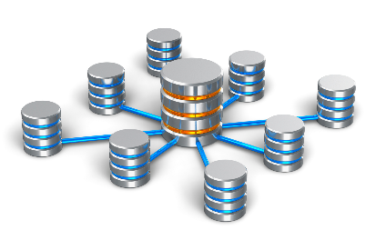
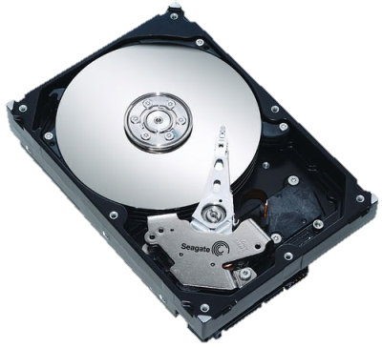

Next-generation Storage Systems
The development of storage technologies is endless.
?
Aim to provide novel designs of data storage/management systems for data-centric computing!
Data Lake
Cloud Storage
Auto Tiering Storage
Data Warehouse
Distributed Storage
Big Data Storage
File Systems
Flash File Systems
Content-aware Storage
Time
https://upload.wikimedia.org/wikipedia/commons/2/23/Lake_mapourika_NZ.jpeg; https://2s7gjr373w3x22jf92z99mgm5w-wpengine.netdna-ssl.com/wp-content/uploads/2016/03/data-warehouse.png

Slide 13


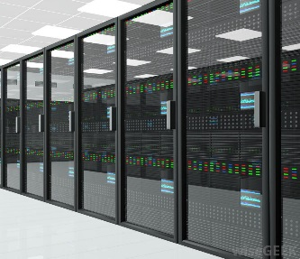
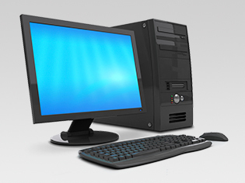
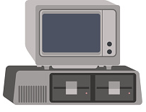
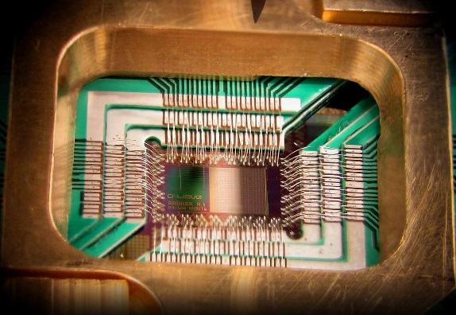



Next-generation Big Data Analytic Platforms
Aim to execute the distributed processing with the minimum latency possible!
?
Spark Ecosystem
Hadoop Ecosystem
Multi-core Computer
Cluster
Single-core Computer
Quantum Computer
Time
http://images.wisegeek.com/room-full-of-computer-servers.jpg; http://www.yodass.com/wordpress/wp-content/uploads/2015/04/hadoop_logo.png; http://spark.apache.org/images/spark-logo-trademark.png; https://www.cloudera.com/content/dam/www/static/images/logos/cloudera-card.jpg; http://hortonworks.com/wp-content/uploads/2016/03/HWX-RGB-full-w-tagline.png; http://static5.businessinsider.com/image/553024cc69bedd7364e8a4d6/heres-why-we-should-be-really-excited-about-quantum-computers.jpg

Slide 14
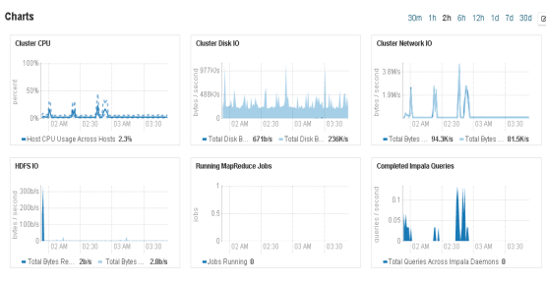
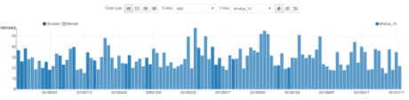

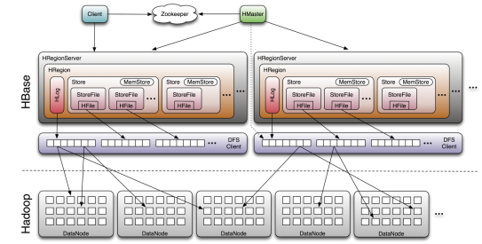
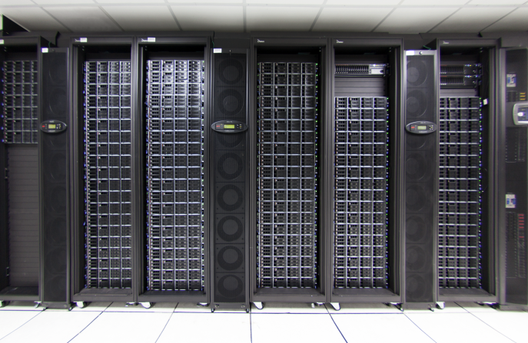
Virtualization Cluster for Big Data Platforms
Advantage
More security
More Scalability
Cluster 1
Cluster 2
Data Analytics and Visualization
VM1
VM2
VM3
VM4
VM5
VM6
VM7
Server 1
Server 2
Big Data Platforms
Virtualization Cluster Management
http://www.datamic.com/articles/image/9c26f9608e9ec1cf5e59a656d18c5f141.jpeg;

Slide 15

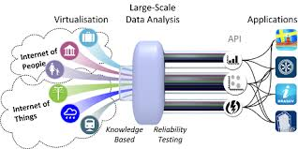
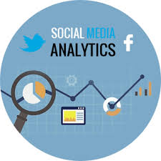
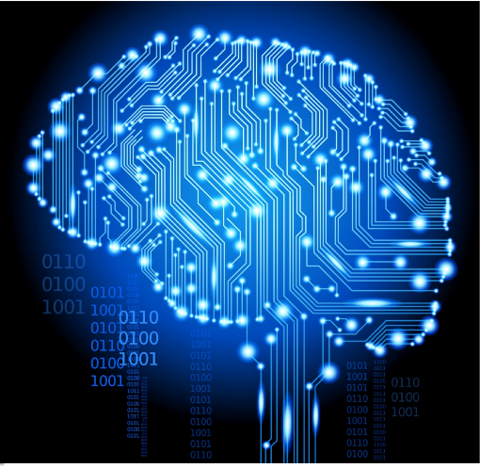

Big Data Analytics Algorithms
MLlib
Apache Spark's scalable machine learning library
Unstructured data analytics
Streaming data analytics
Social media analytics
Deep learning
http://www.datamic.com/articles/image/9c26f9608e9ec1cf5e59a656d18c5f141.jpeg;; http://www.ict-citypulse.eu/page/sites/default/files/traysequence-460_0.png; http://pics.ctitv.com/wpimg/2016/03/112.png; ; http://www.tracksocialmediasales.com/blog/wp-content/uploads/2015/12/social-media-analytic-tool.png; https://geekboy.co/wp-content/uploads/2017/01/deep-learning-in-artificial-intelligence.png

Slide 16
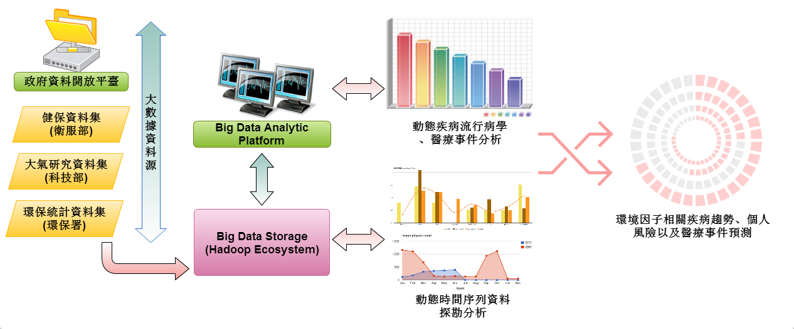
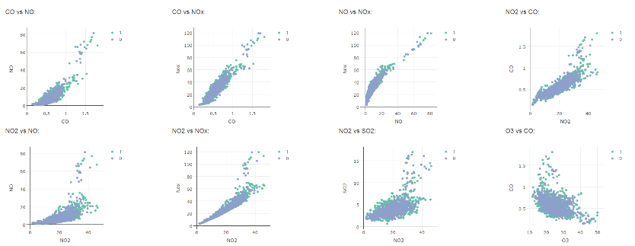
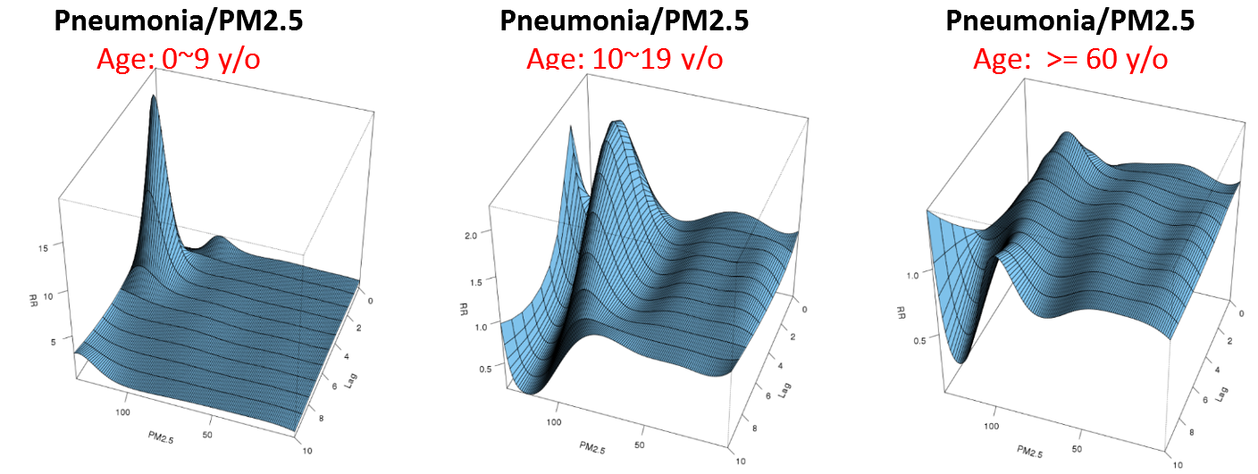
Big Data in Health Care
Construction of a dynamic medical trend analysis and prediction model using medical, environmental and climate data provided by the government
Key factors
Disease
Notes:
接下來我來介紹幾個大數據應用的場域, 第一個是醫療照護, 我們結合健保資料庫, 大氣研究資料庫, 環保統計資料庫, 得到台灣人過去的就醫紀錄、天氣資料、空汙資料 找出疾病發生的關鍵因子，並針對不同的年齡族群建構不同的分析模型，在過去光是要擷取健保資料庫的資料可能需要花上幾天, 現在我們將這些資料存放到大數據平台,
不用10分鐘就可以抓出來, 因此我們可以更有效率的分析資料。該計畫也獲選優良科技部計畫, 並獲邀至行政院作簡報.

Slide 17
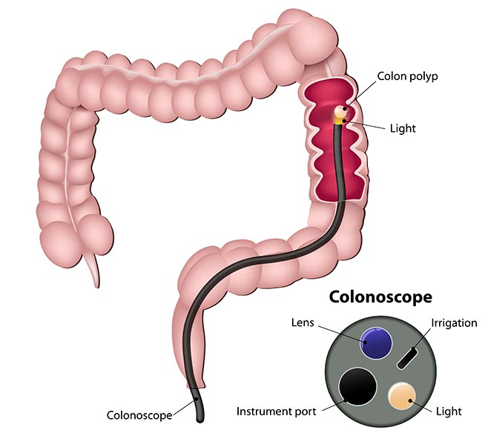
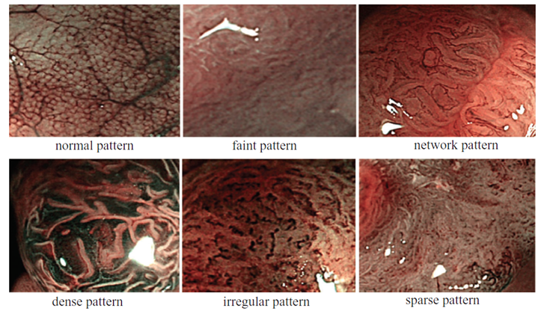
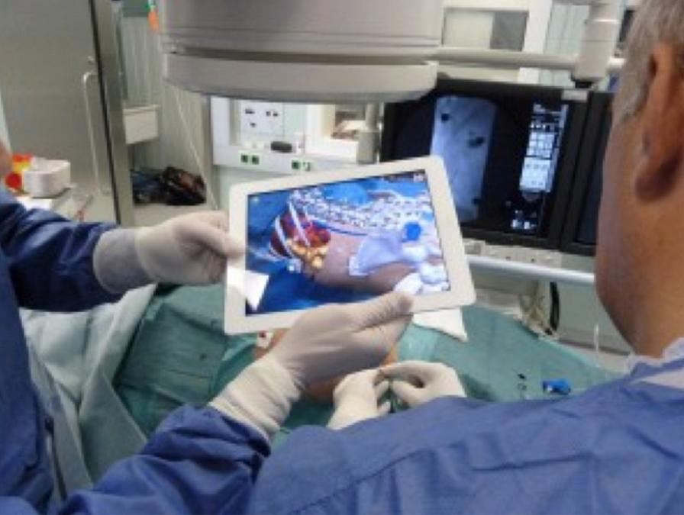
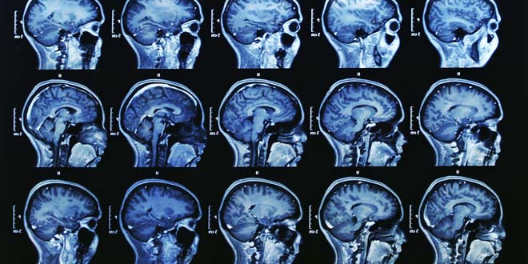
Big Data in Health Care
CT
MRI
Thermal Image

Slide 18
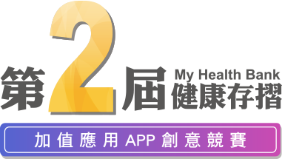
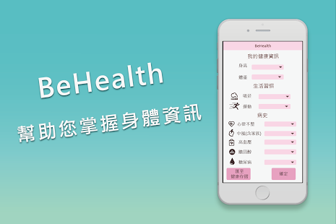
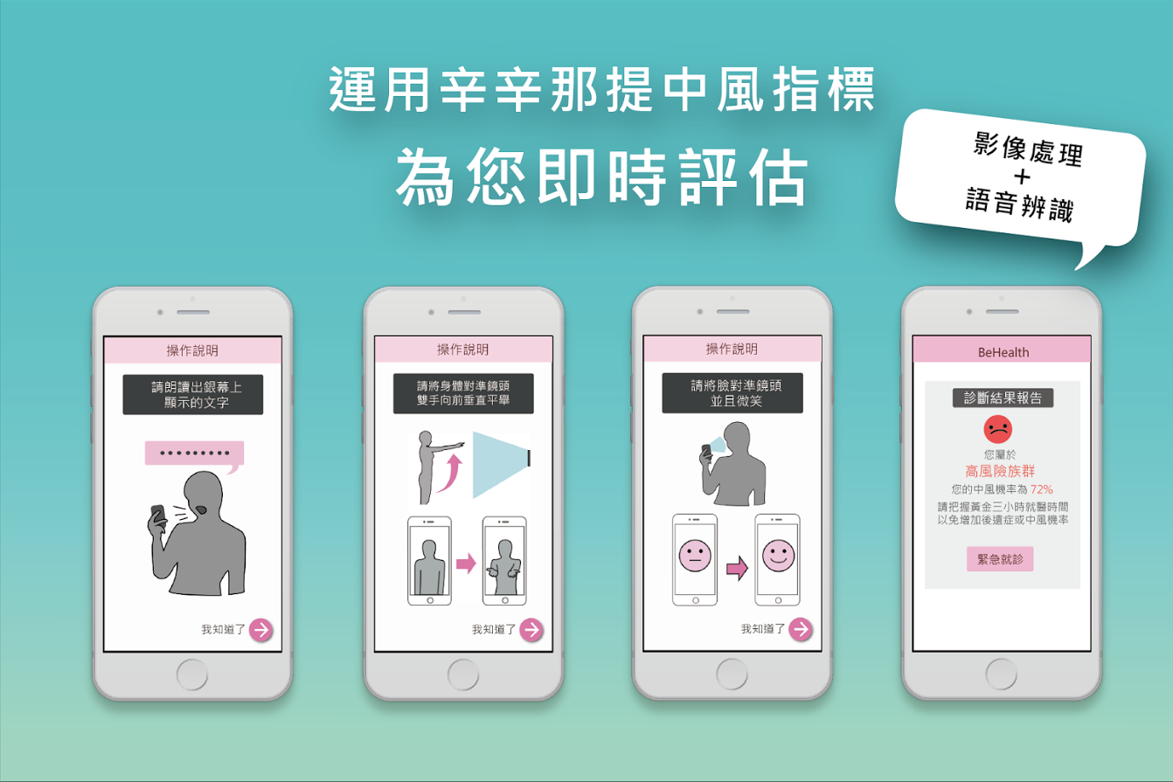
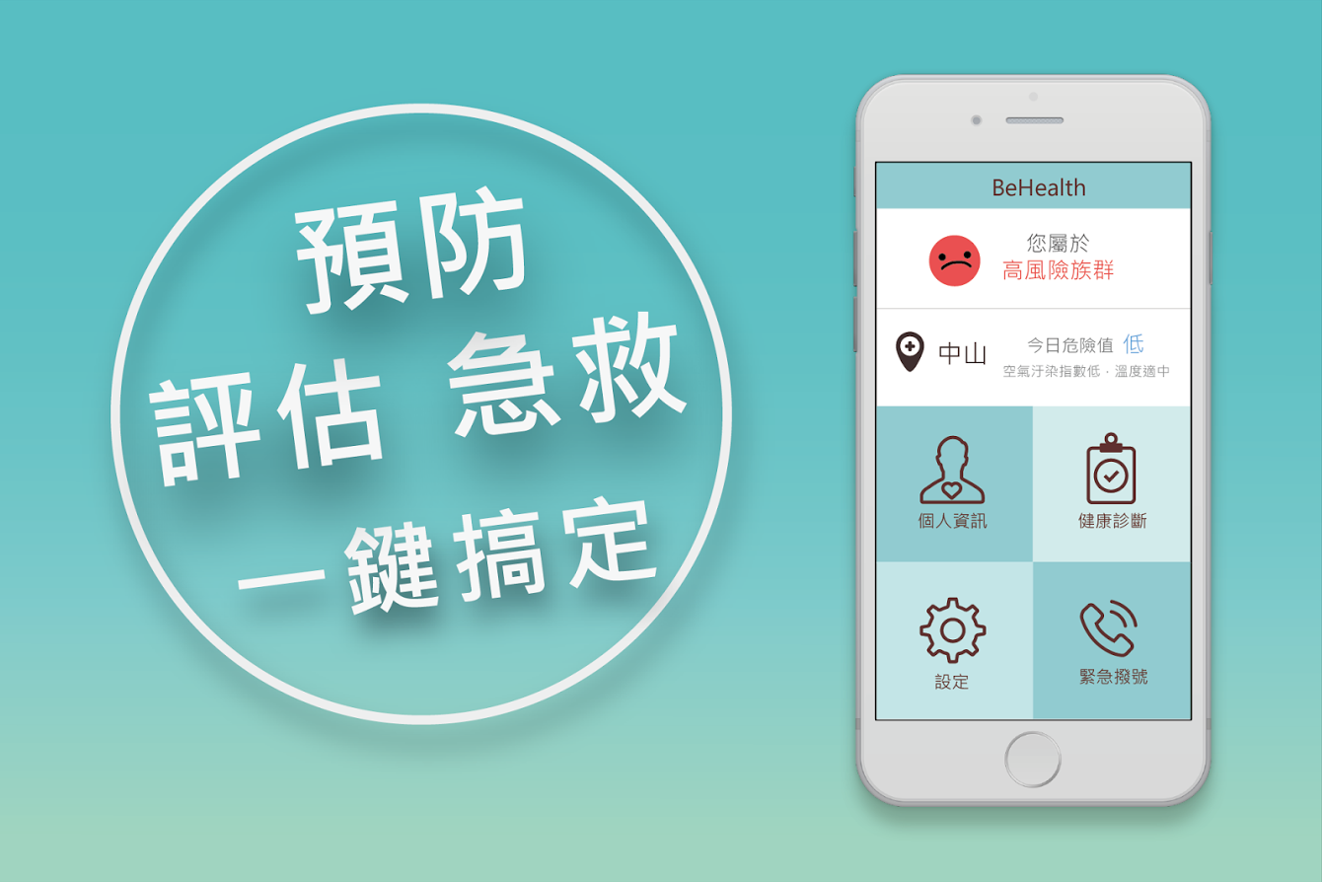
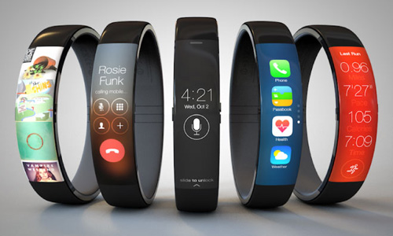
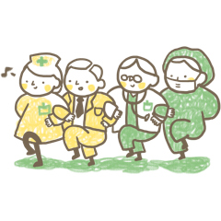
Big Data in Health Care
APP for stroke prediction & detection
Future directions
Wearable devices data analytics
Big data on long-term care
https://youtu.be/qkF9pwKDcM4
http://www.wearabledevices.com/wp-content/uploads/2014/08/iwatch-concept-nike-263x180.jpg http://assets.iing.tw/official/assets/policies_image/geriatric_care/gc5_1-962e3bdddbb2772fd56c50c108d8611a.png;
Notes:
有了剛才的預測模型, 我們建構一個APP，這個APP結合天氣、空汙資料，在結合一些評估指標, 針對不同的族群分析使用者在當下環境是否為中風高風險，
當判定為高風險族群時, 運用辛辛那提中風指標, 利用手機相機進行影像辨識偵測使用者是否有中風的症狀，當有異常時可直接撥打119或是透過google map導航至附近專責醫院
降低因中風造成的危害
在未來, 穿戴式裝置資料分析以及大數據如何應用於長照2.0上, 將是醫療照護領域很重要的研究議題

Slide 19
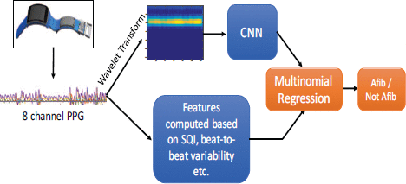
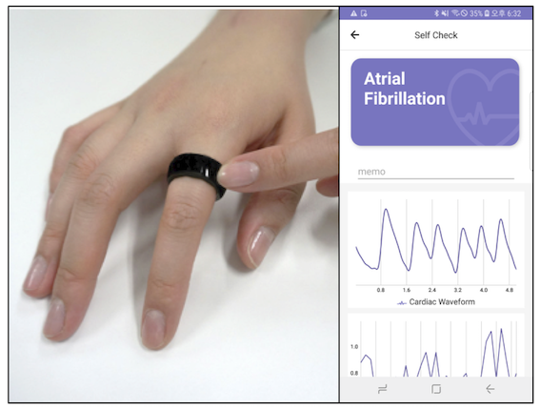
Big Data in Health Care
Wearable device application
https://ieeexplore.ieee.org/abstract/document/7897225
https://www.jmir.org/2020/5/e16443/
Shashikumar, S. P., Shah, A. J., Li, Q., Clifford, G. D., & Nemati, S. (2017, February). A deep learning approach to monitoring and detecting atrial fibrillation using wearable technology. In 2017 IEEE EMBS international conference on biomedical & health informatics (BHI) (pp. 141-144). IEEE.
Kwon, S., Hong, J., Choi, E. K., Lee, B., Baik, C., Lee, E., ... & Yi, Y. (2020). Detection of atrial fibrillation using a ring-type wearable device (CardioTracker) and deep learning analysis of photoplethysmography signals: prospective observational proof-of-concept study. Journal of Medical Internet Research, 22(5), e16443.

Slide 20
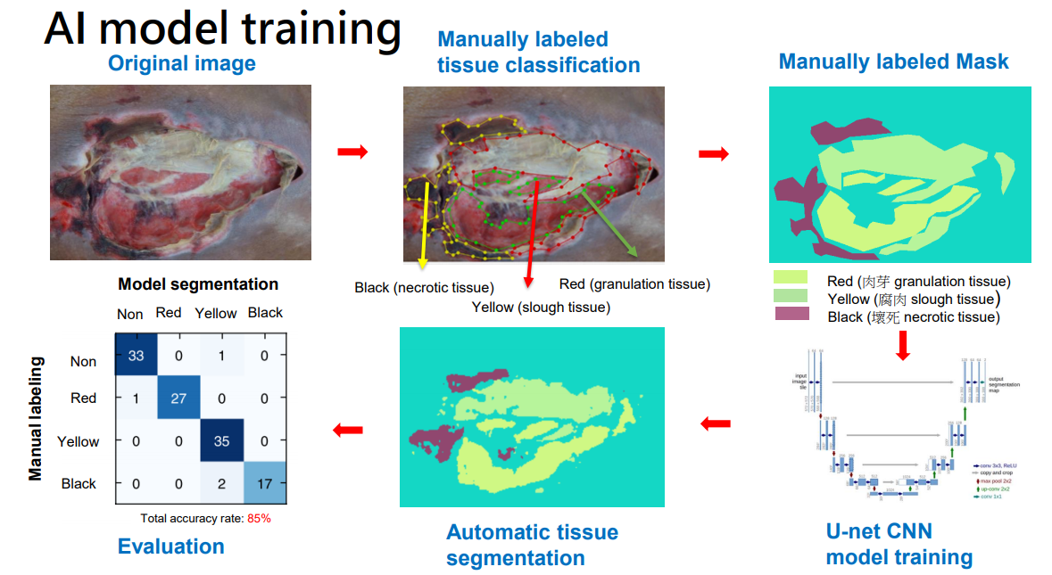
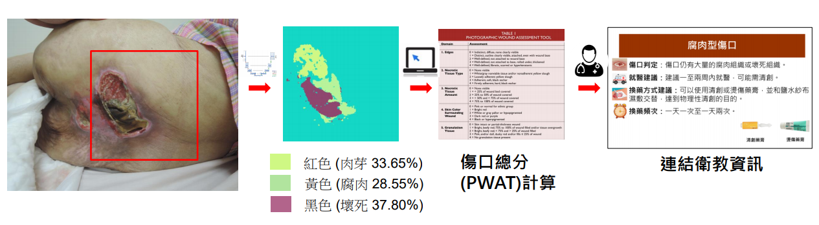
Big Data in Health Care
https://youtu.be/7yoxWVAYTkI

Slide 21
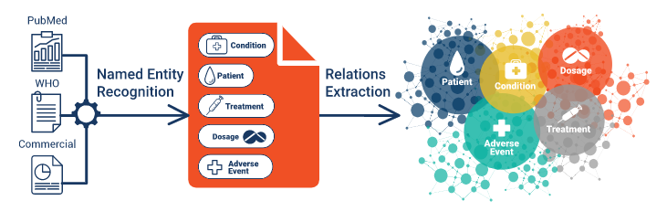
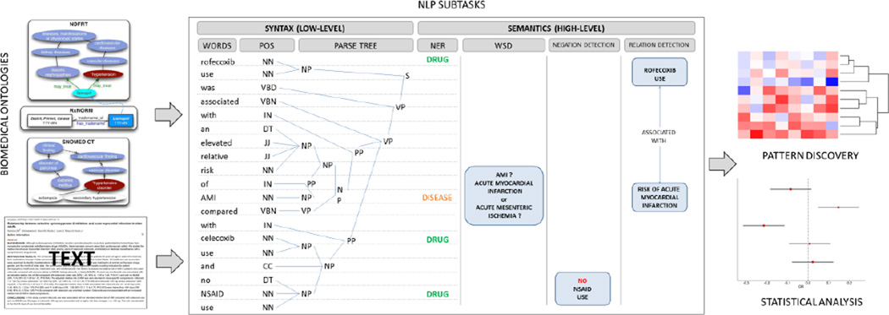
Big Data in Health Care
https://www.ontotext.com/knowledgehub/case-studies/efficient-ai-powered-solution-for-monitoring-drug-adverse-events/
https://www.ncbi.nlm.nih.gov/pmc/articles/PMC4217510/

Slide 22
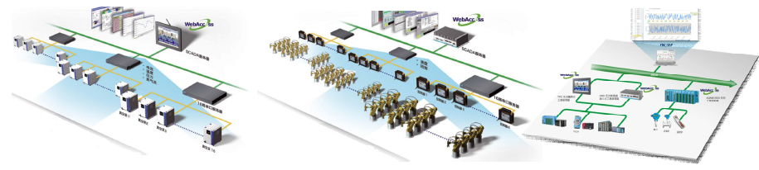
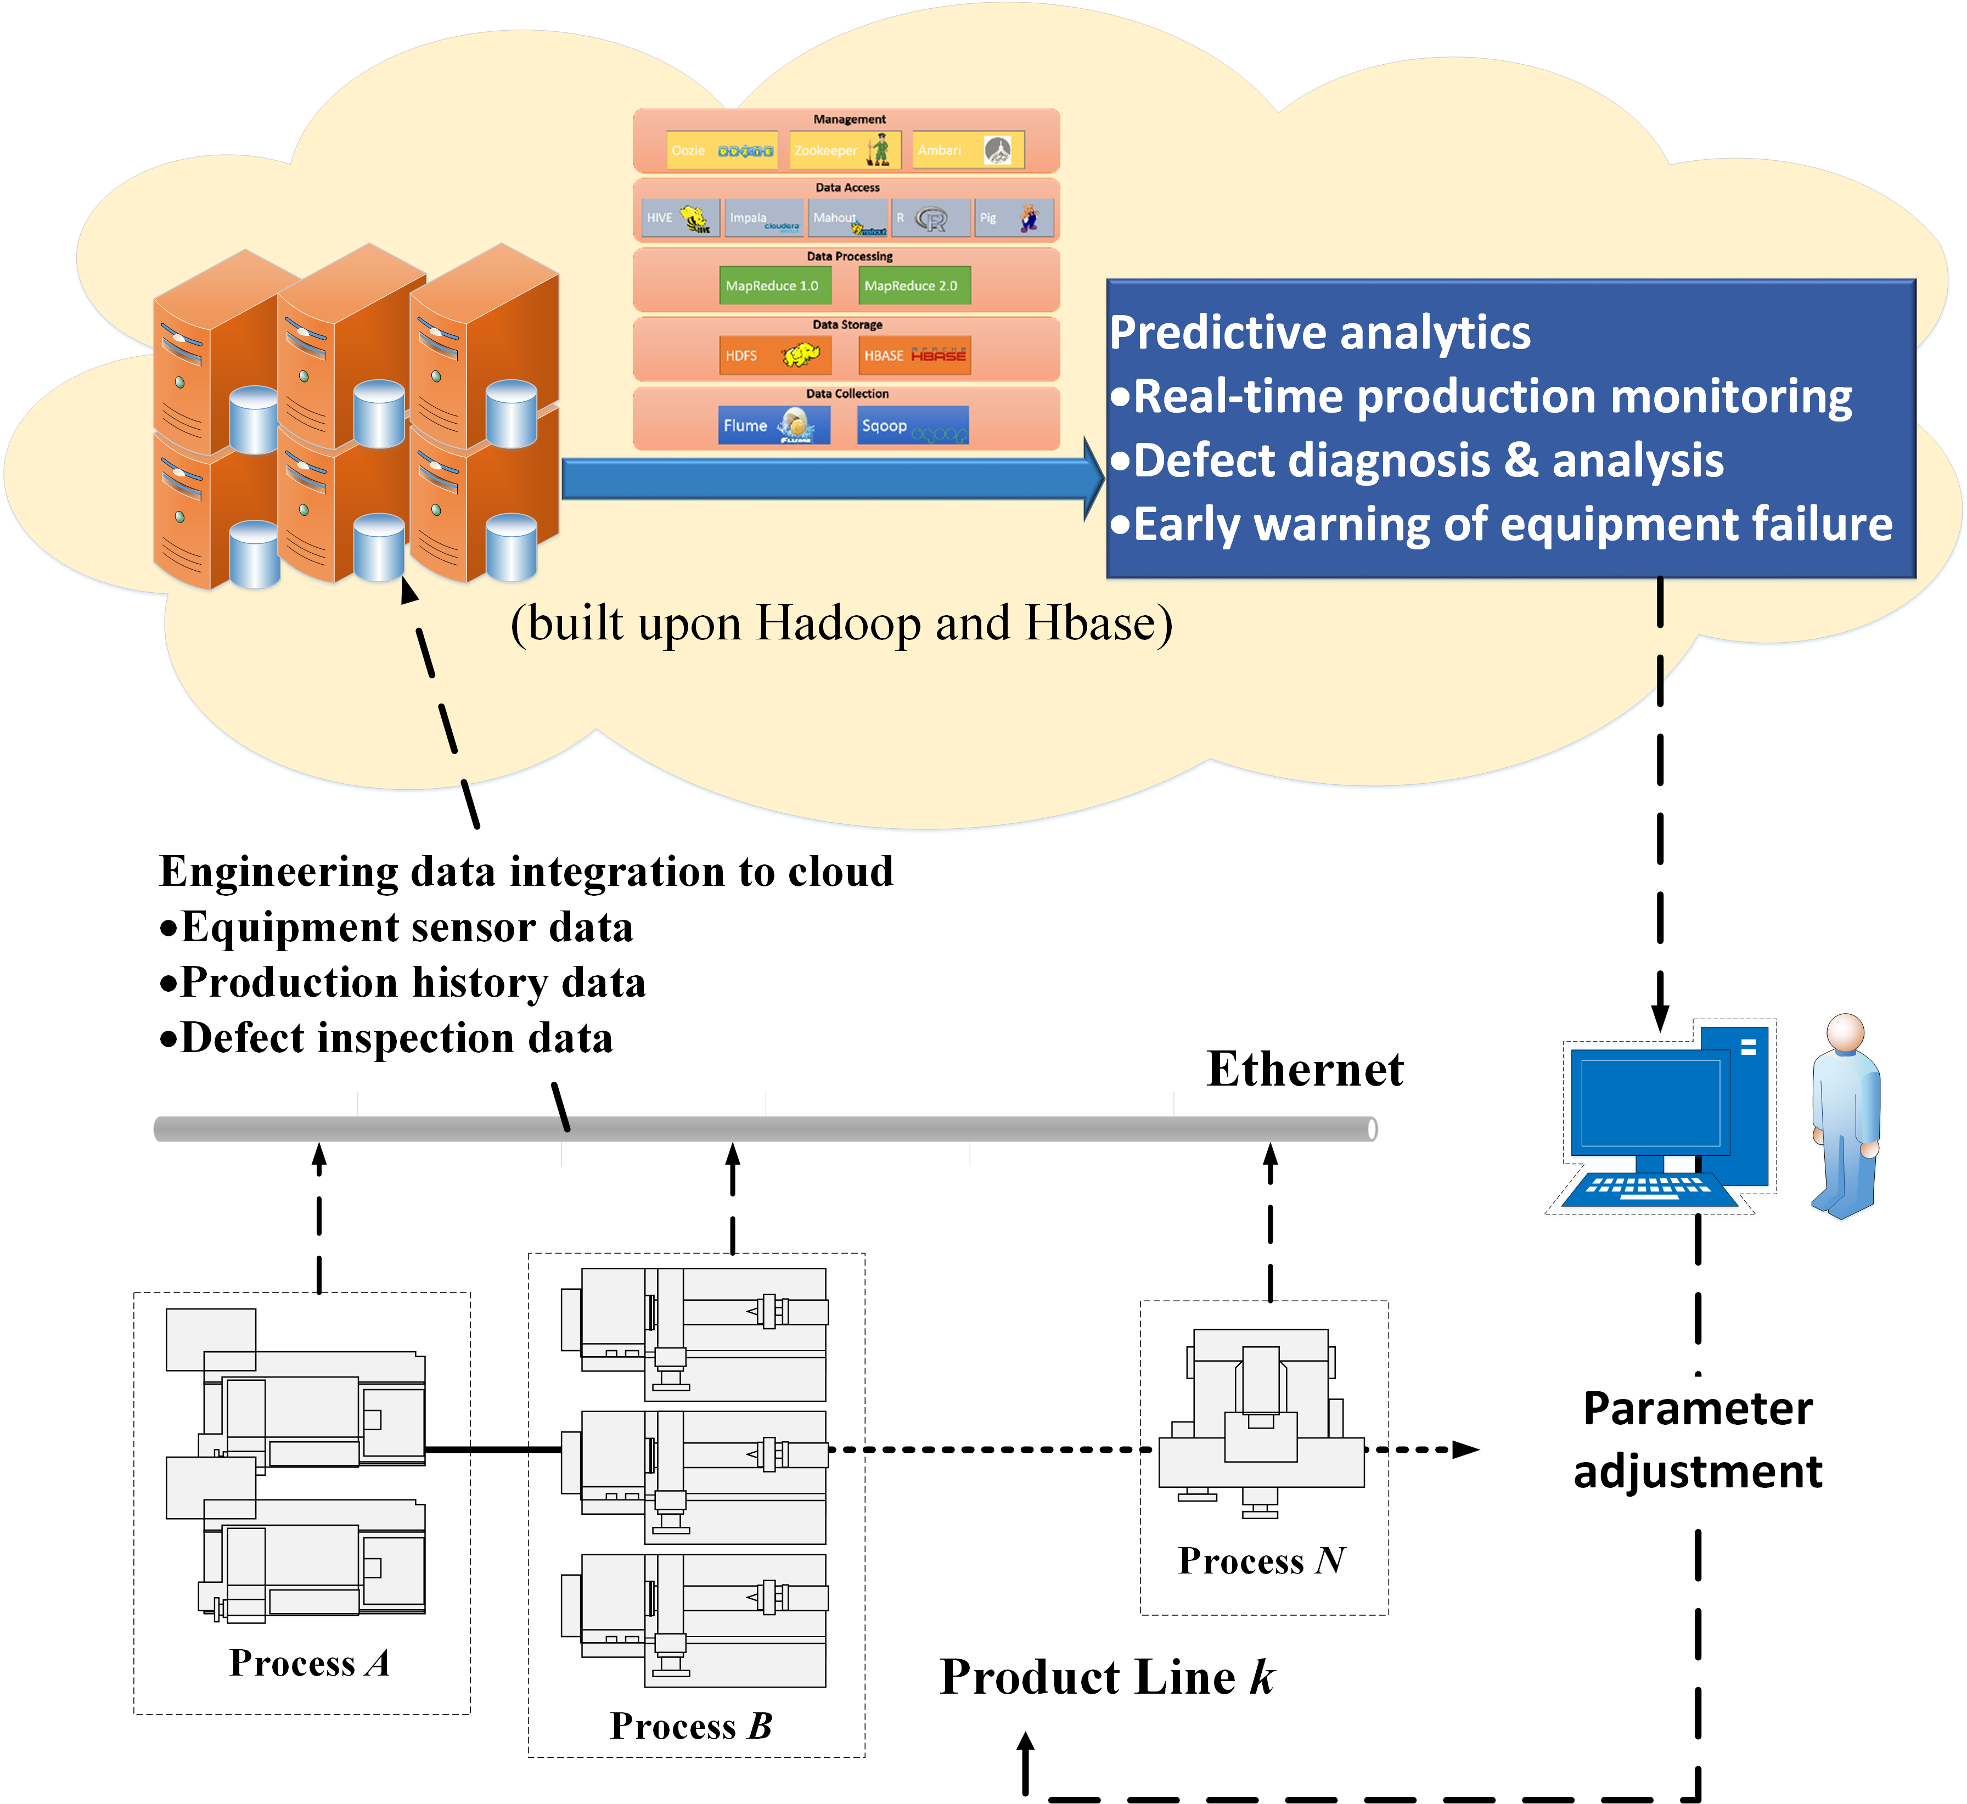
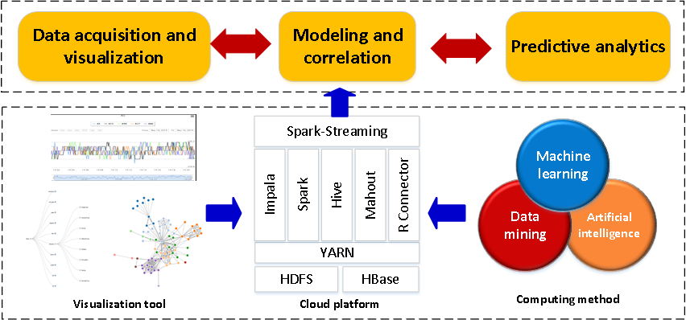
Big Data in Intelligent Manufacturing
Real-time monitoring of a whole factory by integrating different sensor and production line data.
經濟部工業局 (2014.09)
Notes:
第二個應用場域是製造業, 不管在新北市或桃園市, 製造業廠商佔了相當大的一部分. 近年來製造業的競爭越來越激烈, 如何提升產品品質及良率是每家公司所努力的目標
在這裡, 我們建構一個製造業大數據運算平台, 所有的監控資料傳送到這個平台之後, 這個平台可以即時分析所有機台的狀態, 當有異常時告知工程師即時排除問題, 將低不良品的發生率

Slide 23


Big Data in Intelligent Manufacturing
Future directions
Industry 4.0
Smart factory
http://www.bcmcom.com/img/industry_40_factory.jpg; http://cdn2.hubspot.net/hubfs/687152/featured_images/smart_industry.jpg; Gartner (2012)
Notes:
不管是在現在或是在未來, 工業4.0, 智慧工廠將是每個製造業廠商面臨的挑戰, 這也是大數據可切入著墨的地方

Slide 24


Big Data in Intelligent Manufacturing
Action recognition
https://www.youtube.com/watch?v=amJfTgiy4KE

Slide 25



Big Data in Intelligent Manufacturing
Person trajectory analytics

Slide 26



Big Data in Intelligent Manufacturing
Smoke detection
https://www.youtube.com/watch?v=U8Bt_sBfiBM

Slide 27







Big Data in Intelligent Transport
Predict traffic conditions based on GPS data
App for fatigue driving detection
First place, 2016 innovative services awards
https://youtu.be/wAb38Ldgp0o
Notes:
接下來介紹大數據分析如何應用在智慧交通上, 我們利用超過10億筆的計程車GPS資料進行分析, 預測桃園重要道路的路況, 未來可分析民眾上下車地點, 提供市政府大眾交通運輸規劃設計
此外, 我們利用即時影像分析技術, 分析駕駛人行為, 針對個人建構個人化模型, 預測駕駛人是否為疲勞駕駛, 當偵測為疲勞駕駛結合開放資料, 提供民眾附近的休息地點, 以降低事故發生率,
該項作品以申請專利, 並獲得2016年創新應用競賽-桃園開放資料創新應用組第一名的殊榮

Slide 28



Big Data in Intelligent Transport
Future directions
V2V(vehicle-to-vehicle) communication
Autonomous car
https://cdn1-techbang.pixcdn.tw/system/excerpt_images/19677/inpage/e703830a233732e3844e9259e144ad60.png?1408734388 ; https://www.extremetech.com/wp-content/uploads/2014/09/self-driving-head-640x353.jpg ; https://upload.wikimedia.org/wikipedia/commons/thumb/6/65/Hands-free_Driving.jpg/230px-Hands-free_Driving.jpg
Notes:
在未來, V2V(vehicle-to-vehicle) 車聯網以及自動駕駛將是重點研究方向, 如何利用蒐集到的數據改善車子行駛狀態, 將是很重要的議題。

Slide 29

Big Data in Smart City

Slide 30




Big Data in Smart City
Noise detection
Citybike Application

Slide 31




Big Data in Smart City
Citybike Application

Slide 32
Big Data in Business Intelligence
Consumer recommendations, and merchandising
Netflix
http://techblog.netflix.com/2014/10/using-presto-in-our-big-data-platform.html
http://www.huffingtonpost.com/markus-giesler/netflixs-transformation-big-data-vs-big-sociology-_b_5985428.html
Amazon
PCHOME
Finance and economics
stock
http://www.forbes.com/sites/timworstall/2014/08/04/big-data-using-google-searches-to-predict-stock-market-falls/
foreign currency
http://technews.tw/2015/02/10/wall-street-manipulate-currency-exchange/

Slide 33

Data Scientist: America’s Highest-Paying Entry-Level Job
Ref: https://insights.dice.com/2019/05/21/data-scientist-americas-highest-paying-entry-level-job/

Slide 34
Big Data Analytics Framework

Slide 35
Research framework
1. Problem Definition
2. Data Preparation
3. Data Mining & Machine Learning
4. Evaluation & Interpretation

Slide 36


Problem Definition
Example:
Ref: https://www.synapse.org/#!Synapse:syn6187098/wiki/401884

Slide 37

Data Preparation
ETL

Slide 38
Data Format
Structured Data
TXT
CSV
SQL
XML (eXtensible Markup Language)
JSON (JavaScript Object Notation)
…
Unstructured data
Image
Video
Voice
…

Slide 39

Data Format
XML (eXtensible Markup Language)
are three common terms used to describe parts of an XML document:
tags
elements
attributes
<people>
<person id="person_1">
<name>David</name>
<date>2014-01-30</date>
</person>
</people>

Slide 40


Data Format
XML example

Slide 41

Data Format
XML document as a tree
Conceptually, an XML document is a hierarchical structure called an XML tree

Slide 42
Data Format
JSON (JavaScript Object Notation)
A lightweight computer data interchange format
Text-based, human-readable format for representing simple data structures and associative arrays
easy for humans to read and write
easy for machines to parse and generate
Based on a subset of the JavaScript programming language

Slide 43
Data Format
{
"firstName": "John",
"lastName": "Smith",
"age": 25,
"address": {
"streetAddress": "21 2nd Street",
"city": "New York",
"state": "NY",
"postalCode": "10021"
},
"phoneNumber": [
{
"type": "home",
"number": "212 555-1234"
},
{
"type": "fax",
"number": "646 555-4567"
}
],
"gender": {
"type": "male"
}
}
JSON Example

Slide 44
Data Format
JSON to XML
XML to JSON
<Book> <Title>Parsing Techniques</Title> <Authors> <Author>Dick Grune</Author> <Author>Ceriel J.H. Jacobs</Author> </Authors> <Date>2007</Date> <Publisher>Springer</Publisher> </Book>
{ "Book": { "Title": "Parsing Techniques", "Authors": [ "Dick Grune", "Ceriel J.H. Jacobs" ], "Date": "2007", "Publisher": "Springer" } }

Slide 45
Data Format
An XML document is a tree
<Book> <Title>Parsing Techniques</Title> <Authors> <Author>Dick Grune</Author> <Author>Ceriel J.H. Jacobs</Author> </Authors> <Date>2007</Date> <Publisher>Springer</Publisher> </Book>
Book
Authors
Title
Date
Publisher
Author
Author
Parsing Techniques
Dick Grune
Ceriel J.H. Jacobs
2007
Springer

Slide 46
Data Format
A JSON Object is a tree
{ "Book": { "Title": "Parsing Techniques", "Authors": [ "Dick Grune", "Ceriel J.H. Jacobs" ], "Date": "2007", "Publisher": "Springer" } }
Book
Authors
Title
Date
Publisher
["Dick Grune", "Ceriel J.H. Jacobs"]
Parsing Techniques
2007
Springer

Slide 47

Example

Slide 48
Data Mining & Machine Learning
Data Mining
Data Clustering
Data Classification
…
Machine Learning
libSVM
KNN
Bayesian networks
…

Slide 49

Evaluation & Interpretation
correlation does not imply causation
http://en.wikipedia.org/wiki/Correlation_does_not_imply_causation
pirates cause global warming??

Slide 50
Q&A

